Slide 1
The SNOW Theorem
and Latency-Optimal
Read-Only Transactions
Haonan Lu,Christopher Hodsdon, Khiem Ngo
Shuai Mu, Wyatt Lloyd
胡淦森 118037910002

Slide 2
Outline
Motivation & background
The “SNOW” property and theorem
New algorithm design
Evaluation
Take away(summary)

Slide 3
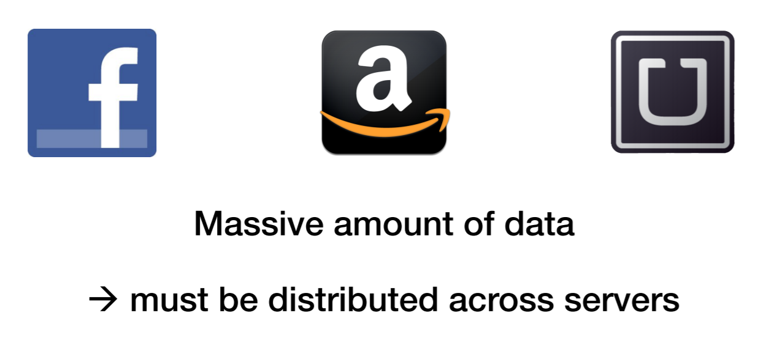
Huge Web Services Shard Data

Slide 4

Huge Web Services Shard Data

Slide 5















Simple Reads Are Insufficient
Web
Clients
Datacenter
Storage Tier
Servers
Load Page
Read
Public
ACL=public
Photo=A

Slide 6







Simple Reads Are Insufficient
Web
Clients
Datacenter
Storage Tier
Servers
Load Page
Read
Public
ACL=private
Set
“Private”
Done
Private
Photo B
Photo=A

Slide 7






Simple Reads Are Insufficient
Web
Clients
Datacenter
Storage Tier
Servers
Load Page
Read
Public
ACL=private
Set
“Private”
Done Photo B
Private
Photo B
Done
Done
Photo=B

Slide 8



Simple Reads Are Insufficient
Web
Clients
Datacenter
Storage Tier
Servers
Load Page
Read
Public
ACL=private
Photo B
Read
Private
Photo B
Photo B
Done
Photo=B

Slide 9






Simple Reads Are Insufficient
Web
Clients
Datacenter
Storage Tier
Servers
Load Page
Read
Public
ACL=private
Photo B
Not
Read
Private
Acceptable!
Photo B
Photo B
Done
Photo=B

Slide 10
What’s the problem here?
Inconsistent Read
Solution:
Use Transactions to provide consistent read across servers

Slide 11
Read-Only Transactions
Transactions that do not modify data
Consistently read data across servers

Slide 12
The Power of Read-Only Txn
Consistency restricts what can be read
Eliminates unacceptable combinations
Compatibility write transactions
Write transactions atomically update data
Higher power->more useful
Stronger consistency->higher power
Compatibility->higher power

Slide 13





Read-Only Transaction
High Power Low Latency
Reduces anomalies
(the ACL – Photo example)
Easier to reason about
Better user experience
Higher revenue

Slide 14
Can we achieve both?
High Power Low Latency
Reduces anomalies
(the ACL – Photo example)
Easier to reason about
Better user experience
Higher revenue

Slide 15
Can we achieve both?
High Power Low Latency
Reduces anomalies
(the ACL – Photo example)
Easier to reason about
Better user experience
Higher revenue
The paper proves: highest power + lowest latency is
impossible

Slide 16
Outline
Motivation & background
The “SNOW” property and theorem
New algorithm design
Evaluation
Take away(summary)

Slide 17
The SNOW Properties
[S]trict serializability
[N]on-blocking operations [O]ne response per read
[W]rite transactions that conflict

Slide 18


The SNOW Properties
[S]trict serializability
Highest Power
[W]rite transactions that conflict
[O]ne response per read
Lowest
Latency
[N]on-blocking operations

Slide 19








[S]trict Serializability
Strongest model: real-time + total order
C_{R}
^{S}ACL ^{S}Photo
C_{W}

Slide 20








[S]trict Serializability
Strongest model: real-time + total order
C_{R}
^{S}ACL ^{S}Photo
C_{W}
W starts
Private
ACL := Private Upload Photo B
Photo B
W finishes

Slide 21





[S]trict Serializability
Strongest model: real-time + total order
C_{R}
^{S}ACL ^{S}Photo
C_{W}
W starts
Private
ACL := Private Upload Photo B
Photo B
W finishes
R starts
R finishes

Slide 22




[S]trict Serializability
Strongest model: real-time + total order
C_{R}
^{S}ACL ^{S}Photo
C_{W}
W starts
Private
“Photo B is private!”
ACL := Private Upload Photo B
Photo B
W finishes
R starts
R finishes

Slide 23

















[S]trict Serializability
Strongest model: real-time + total order
C_{R}
^{S}ACL ^{S}Photo
Photo B
C_{W}
W starts
R starts
ACL := Private Upload Photo B
Private
W finishes
R finishes

Slide 24



[S]trict Serializability
Strongest model: real-time + total order
C_{R}
^{S}ACL ^{S}Photo
Photo B
C_{W}
W starts
R starts
ACL := Private Upload Photo B
“Public + Photo A” “Photo B is private!”
“Public + Photo B” “Photo A is private!”
Private
W finishes
R finishes

Slide 25
[N]on-blocking Operations
Do not wait on external events
Locks, timeouts, messages, etc.
Lower latency
Save the time spent blocking

Slide 26
[O]ne Response
One round-trip
No message redirection
Centralized components: coordinator, etc.
No retries
Save the time for extra round-trips
One value per response
Less time for transmitting, marshaling, etc.

Slide 27
[W]rite Transactions That Conflict
Compatible with write transactions
Richer system model
Easier to program

Slide 28
The SNOW Theorem:
Impossible for read-only transaction algorithms to have all SNOW properties

Slide 29
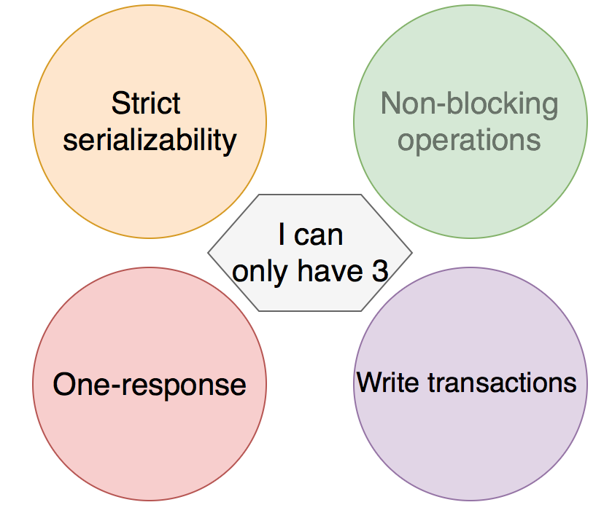
The SNOW Theorem:

Slide 30



Why SNOW Is Impossible
C_{R}
C_{w}
S_{A} S_{B} C_{W}

Slide 31

Why SNOW Is Impossible
C_{R}
C_{R}
C_{w}
S_{A} S_{B} C_{W}
Assume SNOW
W starts
A := new B := new
R
W
invisible
T
W
visible
R_{A} = new R_{B} = old
W finishes

Slide 32


Why SNOW Is Impossible
C_{R}
C_{R}
C_{w}
S_{A} S_{B} C_{W}
Assume SNOW
W starts
A := new B := new
R
W
invisible
Violates property S
T
W
visible
R_{A} = new
R_{B} = old
W finishes

Slide 33
A Deeper Look at SNOW
SNOW is tight
Any combination of 3 properties is possible
Optimality
SNOW-optimal: have any 3 properties
Latency-optimal: have property N and O
Spectrums of property S and O
Show what is possible to achieve

Slide 34
Outline
Motivation & background
The “SNOW” property and theorem
New algorithm design
Evaluation
Take away(summary)

Slide 35










Improve Existing Systems
with the SNOW Theorem
COPS [SOSP ’11]
Geo-replicated
Causally consistent
– Read-only txn : S
N O W
Rococo [OSDI ’14]
Supports general transactions
Strictly serializable
Read-only txn: S N O W

Slide 36
New Algorithm Designs
COPS-SNOW
Latency-optimal (N + O)
Rococo-SNOW
SNOW-optimal (S + O + W)
Design insight for optimizing reads: shift the overhead to writes

Slide 37
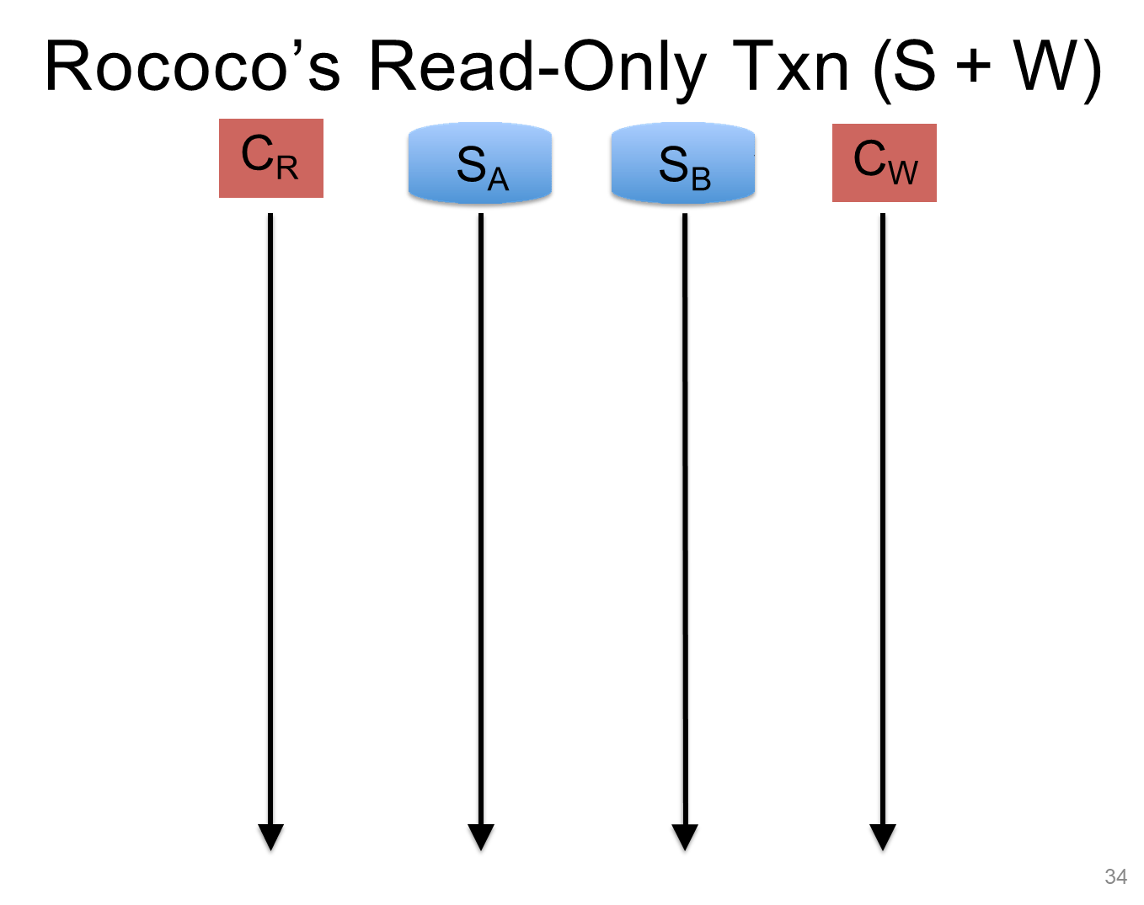


Slide 38
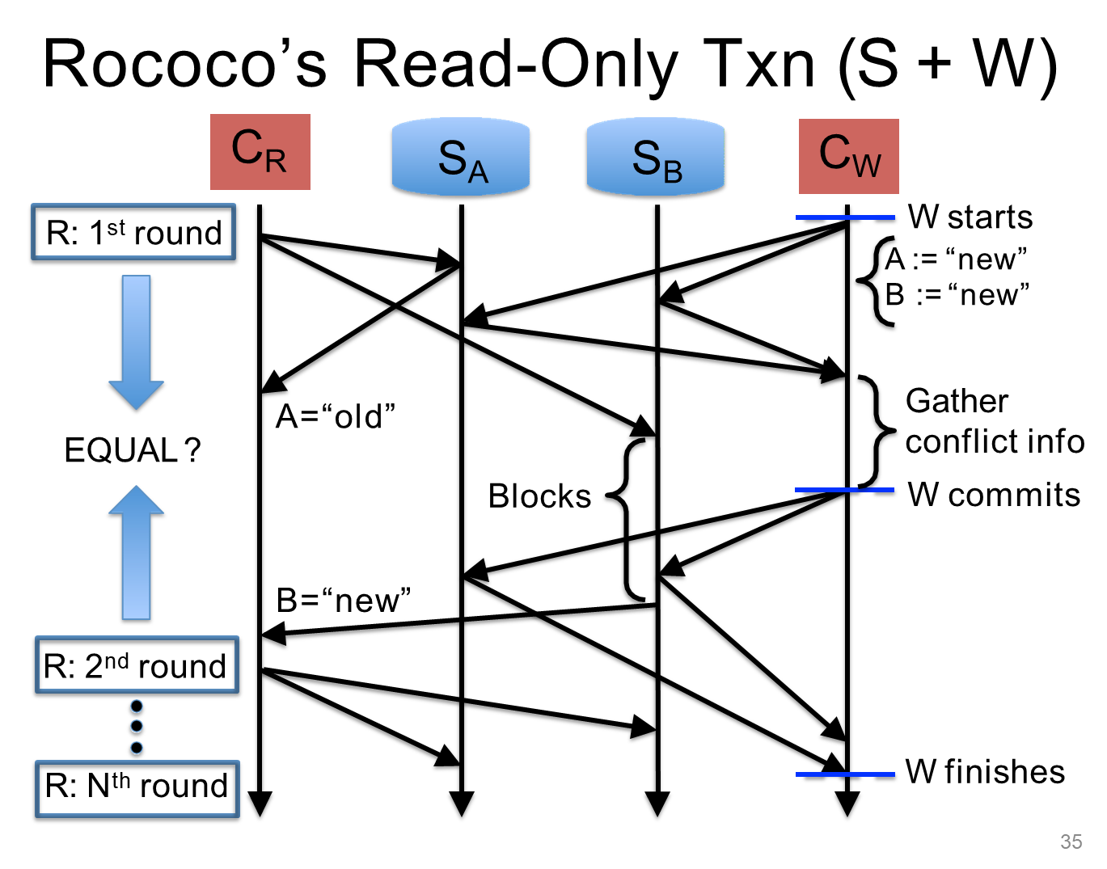


Slide 39
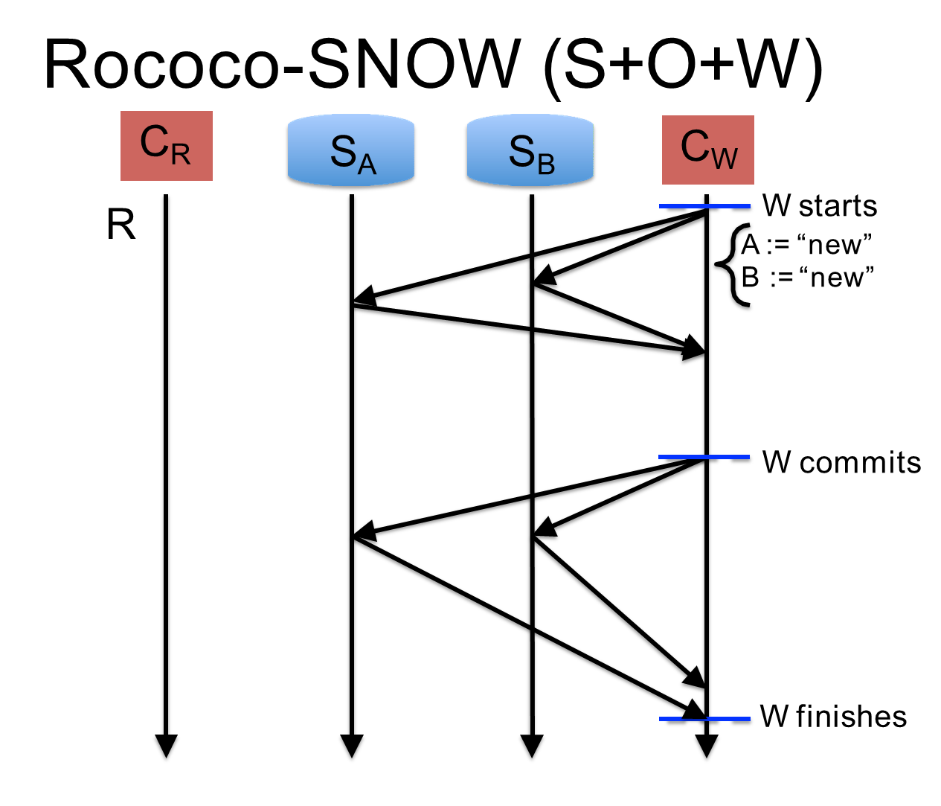

Slide 40
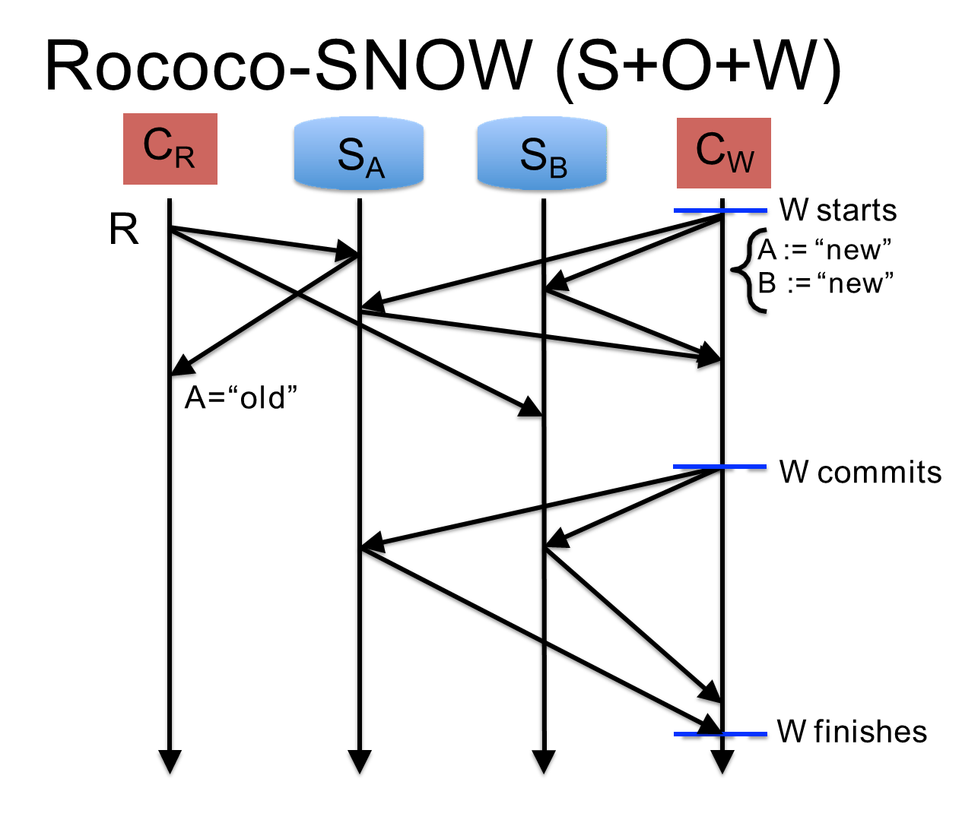

Slide 41
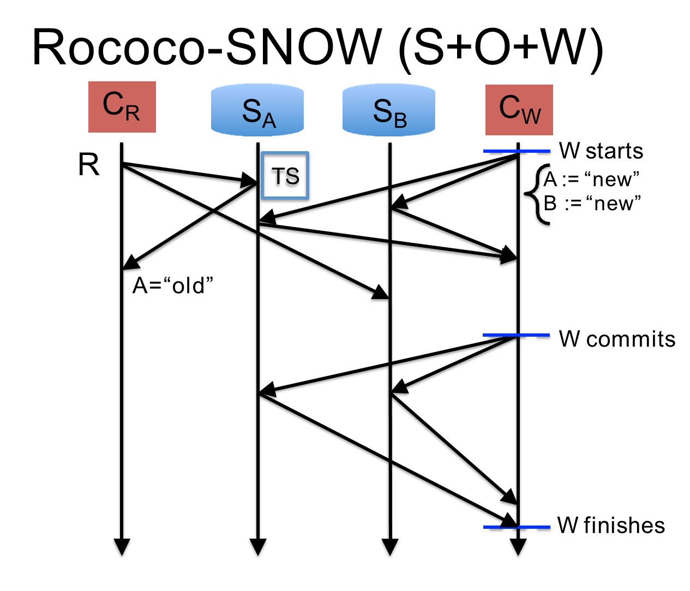

Slide 42
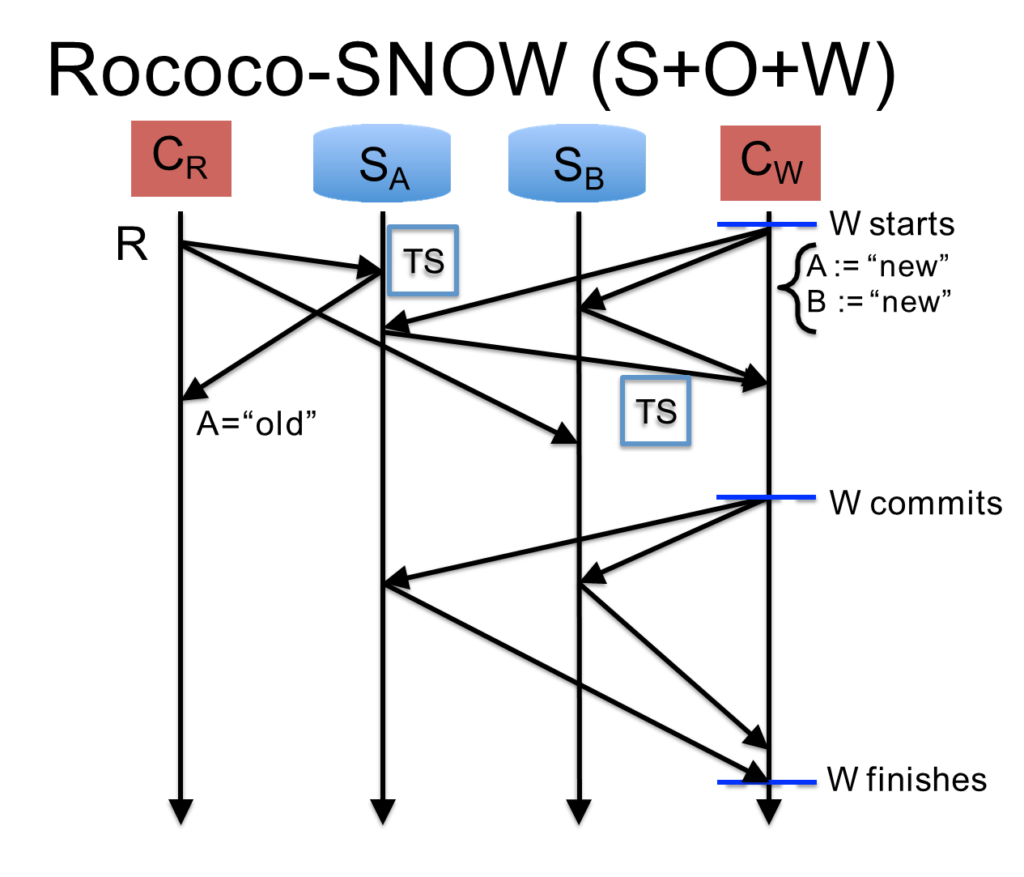

Slide 43


Slide 44
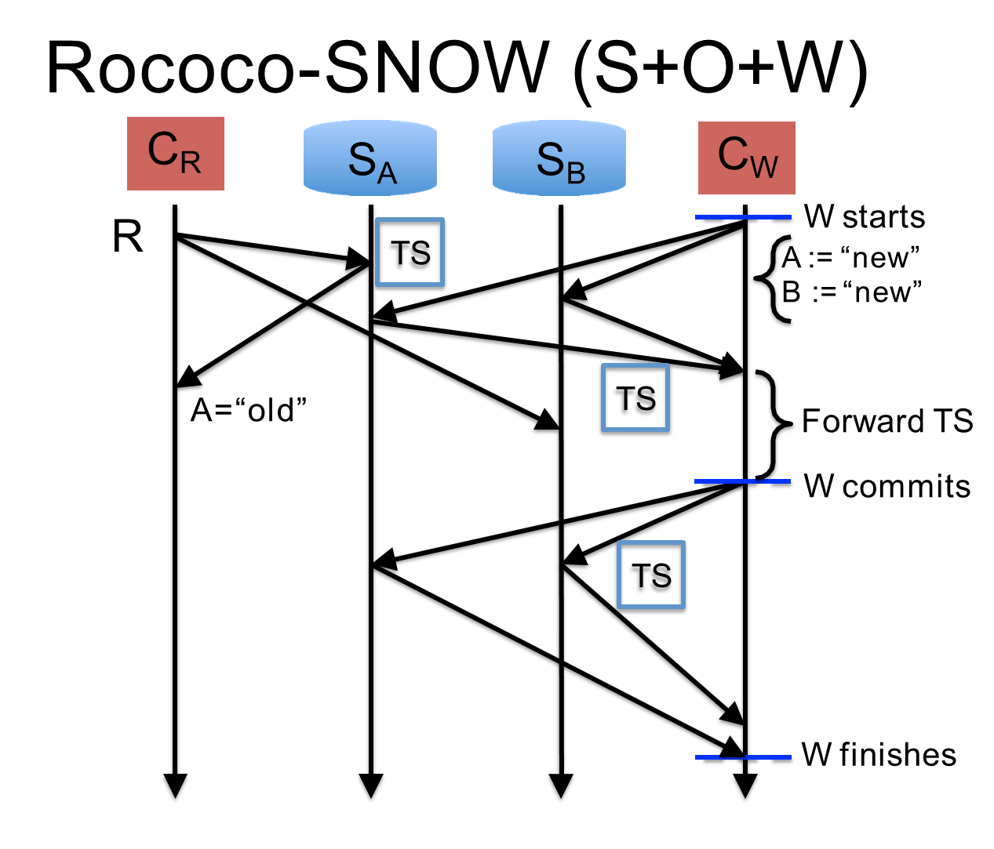

Slide 45
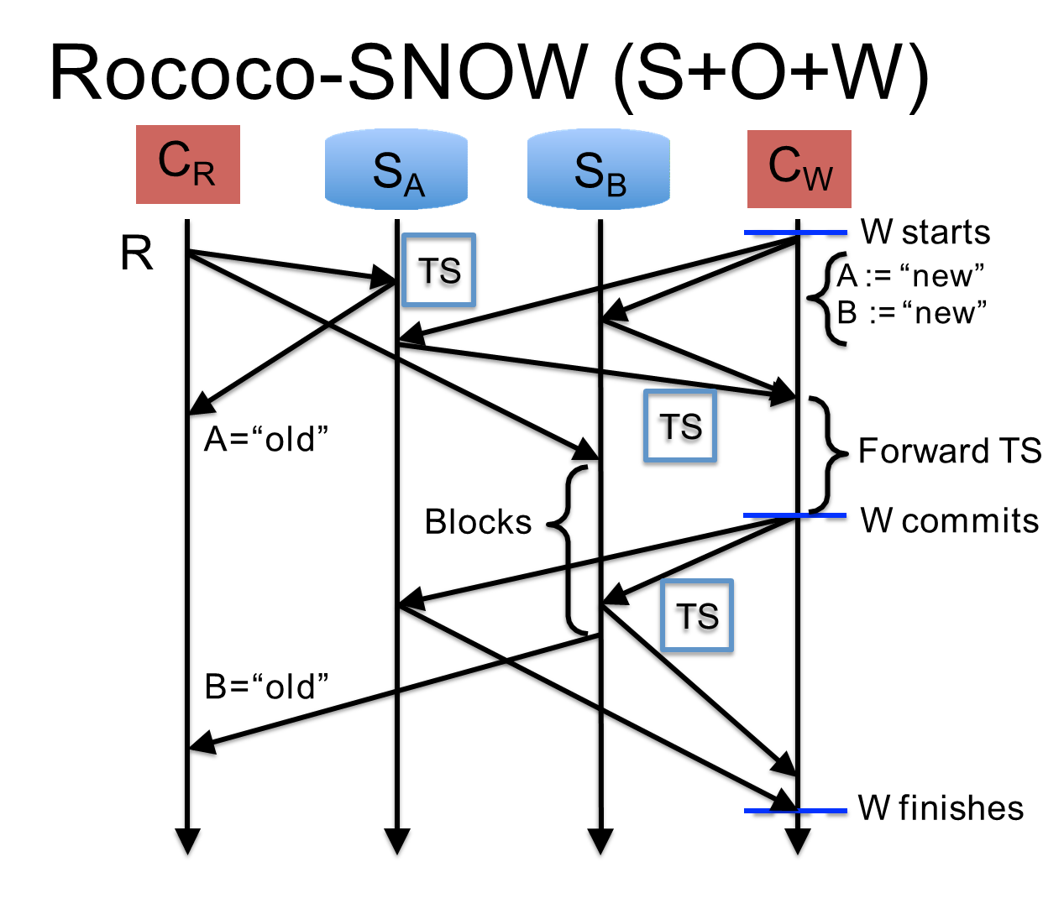

Slide 46
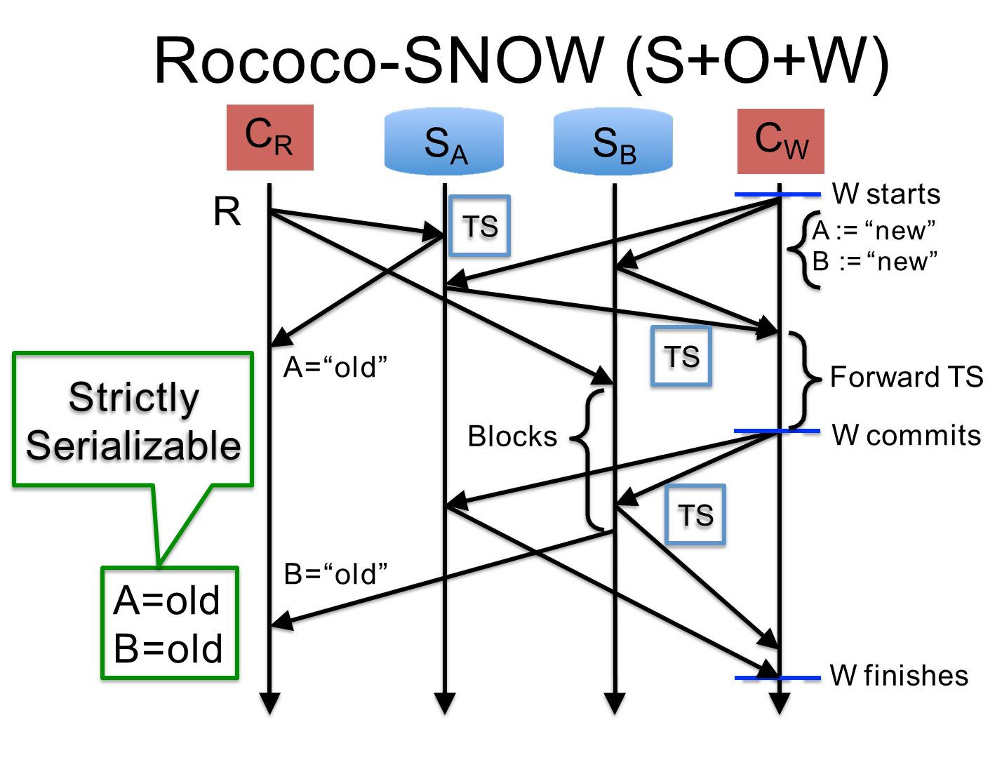

Slide 47
Outline
Motivation & background
The “SNOW” property and theorem
New algorithm design
Evaluation
Take away(summary)

Slide 48
Evaluation of Rococo-SNOW
To understand
Latency of read-only transactions
Throughput of other types of transactions
Experiment configuration
Identical to Rococo’s
TPC-C workloads

Slide 49





Significantly Lower Latency
for Read-Only Txn
1200
1000
800
600
400
200
0
OCC
Latency (ms)
Rococo
2PL
Rococo
-SNOW
0
20
40
60
80
100
Concurrent requests/server

Slide 50







Significantly Lower Latency
for Read-Only Txn
1200
1000
800
600
400
200
0
OCC
Lock Wait
Latency (ms)
Retries
Always 1 round
Rococo
2PL
Rococo
-SNOW
0
20
40
60
80
100
Concurrent requests/server

Slide 51





Higher Throughput
under High Contention
6000
5000
4000
3000
2000
1000
0
Throughput (new-order/s)
Rococo
-SNOW
Rococo
2PL OCC
0
20
40
60
80
100
Concurrent requests/server

Slide 52








Higher Throughput
under High Contention
6000
5000
4000
3000
- 1 4 % throughput
Throughput (new-order/s)
Rococo
-SNOW
Rococo
2X throughput (High Contention)
1000
0
(Low Contention)
2PL OCC
0
20
40
60
80
100
Concurrent requests/server

Slide 53
Outline
Motivation & background
The “SNOW” property and theorem
New algorithm design
Evaluation
Take away(summary)

Slide 54
Summary
The “SNOW” is impossible
There is a fundamental trade-off between the power and latency of read-only transactions
Help understand existing read-only systems
Help avoid trying to improve systems that we cannot
Two new systems COPS-SNOW (Latency-optimal) and Rococo-SNOW(SNOW-optimal)
Both reduce the read latency at the cost of making the write algorithm more complex

Slide 55

Thanks

